Slide 1
Understanding Artificial Neural Networks

Slide 2
ANN
Theory Topics
Perceptron Model to Neural Networks
Activation Functions
Cost Functions
Feed Forward Networks
BackPropagation

Slide 3
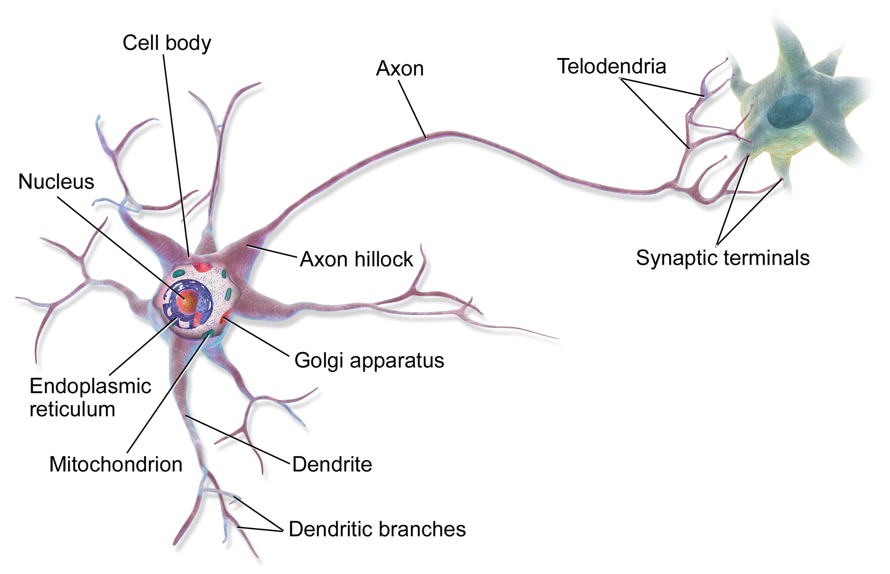
Perceptron Model
Illustration of biological neurons
Illustration of biological neuron

Slide 4
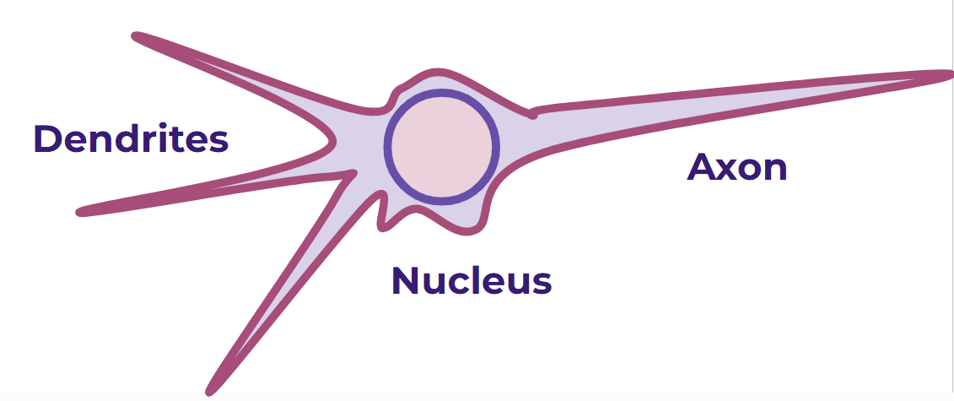
Perceptron Model
Simplified Biological Neuron Model

Slide 5
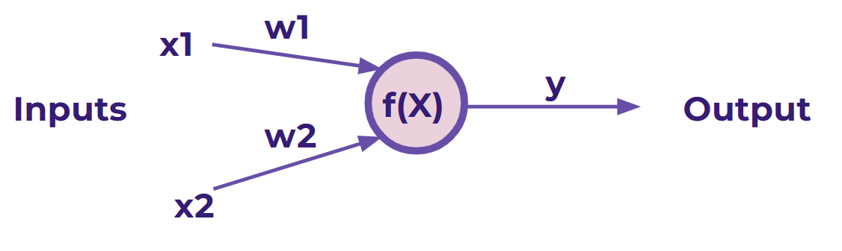
Perceptron Model
Perceptron Model
x1 , x2 = Inputs
w1 , w2 = Weights
f(X) = Activation Functions
y= Output

Slide 6
Perceptron Model
Perceptron Model
if f(X) is addition then:
y=x1w1+x2w2

Slide 7
Perceptron Model
Perceptron Model
if f(X) is addition then:
y=x1w1+x2w2

Slide 8
Perceptron Model
Perceptron Model
We can update weights to guess y
For supervised Learning
X1=2, x2=3 and y=13
Find w1 and w2?

Slide 9
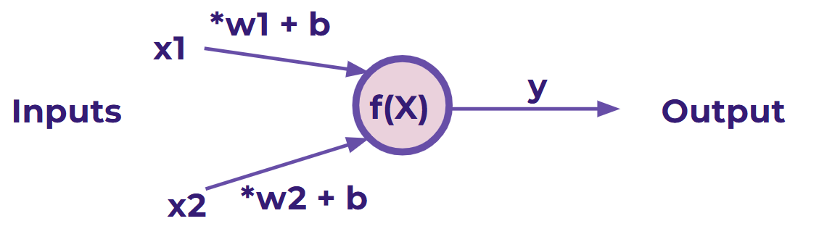
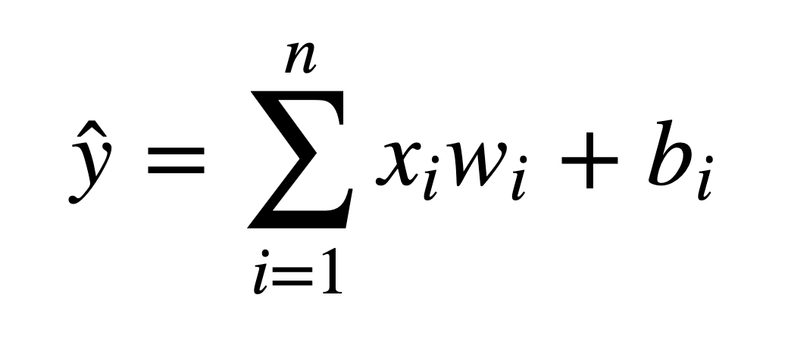
Perceptron Model
But what if an x is zero? w won’t change anything!

Slide 10
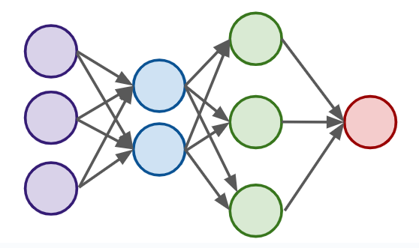
Neural Networks
Input Layer
Hidden Layers
Output Layer

Slide 11
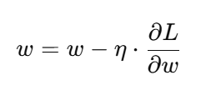
Gradient Descent
Gradient descent is an optimization algorithm used to minimize the loss function of a model by updating weights.
Loss function (L): Measures error between predictions and actual values.
Gradient: Derivative of loss w.r.t. weights ( ∂L/∂w )
Update rule:

Slide 12
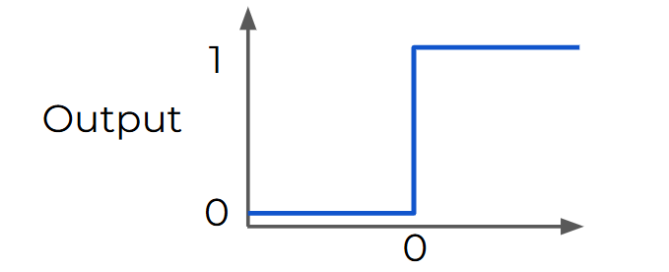
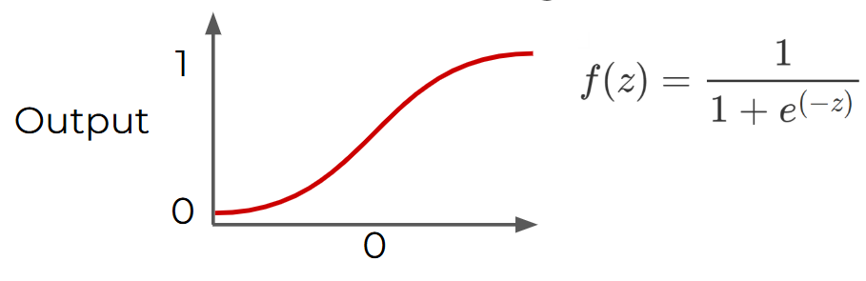
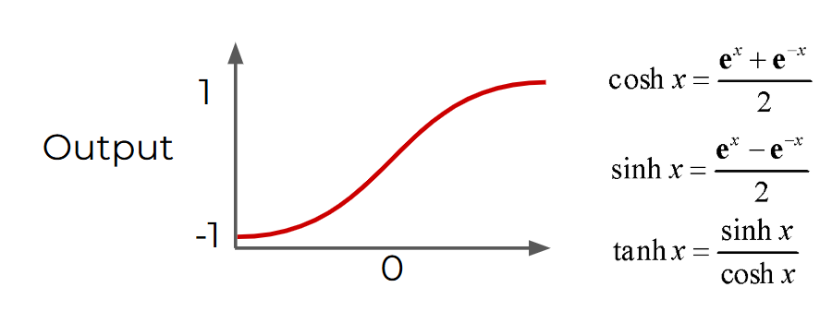
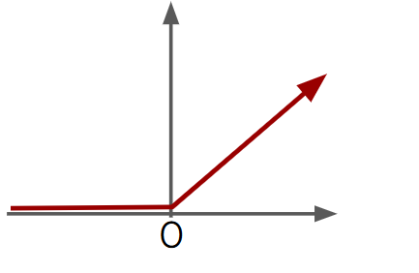
Activation Functions
Step
Sigmoid
tanh
RELU

Slide 13
Vanishing Gradient
Neural networks are trained using backpropagation.
During backpropagation, the gradient (partial derivative of loss w.r.t. weights) is propagated backward through layers.
If the activation function has very small derivatives (like sigmoid or tanh in extreme values), the gradients shrink as they move backward.
After many layers, gradients can become close to zero, so earlier layers stop learning (weights barely update).
This is called the Vanishing Gradient Problem.

Slide 14
Activation Functions
After weighted sum, value is passed through a non-linear activation function at each neuron.
Step function acts like a binary threshold but cannot capture complex patterns.
Step function is flat except x=0, thus no weight updates during backpropagation, network cannot learn.
Sigmoid function smooths S-Shape and map input to probabilities. It can cause vanishing gradients for large |x|
RELU passes positive values turns negatives to 0. Helps avoid vanishing gradients (for positive values).

Slide 15
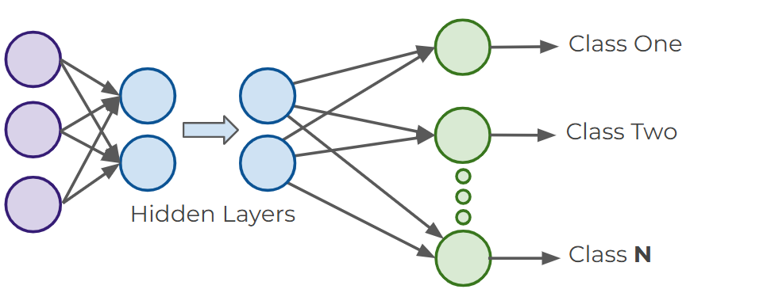
Multiclass Classification
Organizing for multiple classes

Slide 16
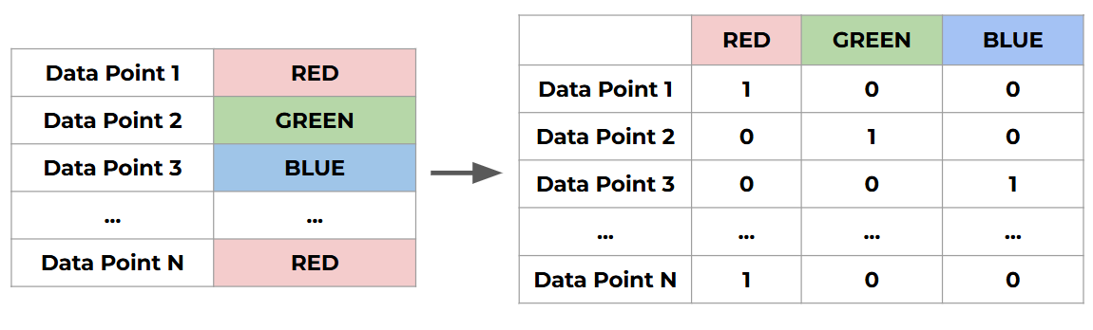
Multiclass classification
Mutually Exclusive classes (One-Hot Encoding)

Slide 17
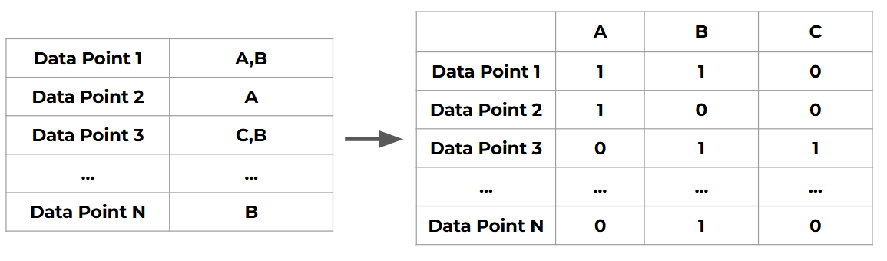
Multiclass classification
Non-Exclusive classes (One-Hot Encoding)

Slide 18
Multiclass classification
Non-exclusive
Sigmoid function
Each neuron will output a value between 0 and 1, indicating the probability of having that class assigned to it.

Slide 19
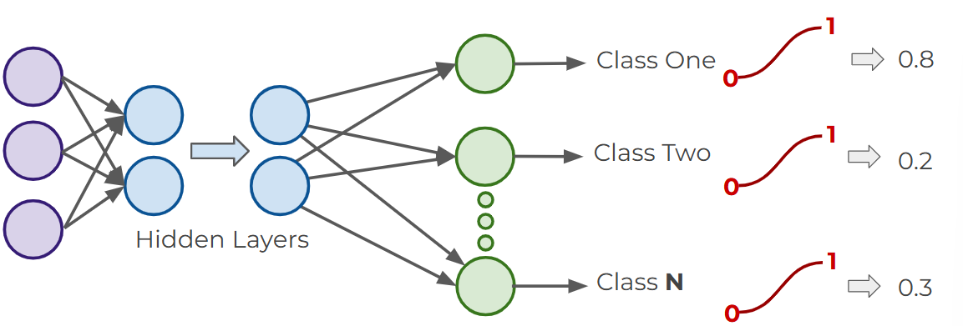
Multiclass classification
Sigmoid function for Non-Exclusive classes

Slide 20
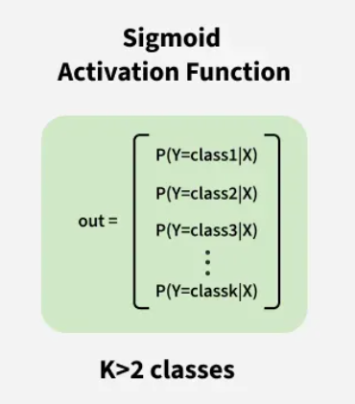
Multiclass classification
Sigmoid function for Non-Exclusive classes
For input, the sigmoid function outputs a probability value. In binary classification, this represents the probability of the input belonging to the positive class(between 0 and 1).
The probability of the negative class can be obtained by subtracting this value from 1.

Slide 21
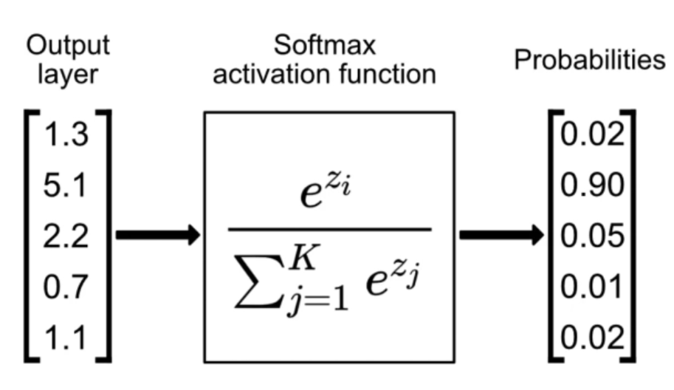
Multiclass classification
Softmax function for Exclusive classes
The probabilities for each class all sum up to 1. We choose the highest probability as our assignment.

Slide 22
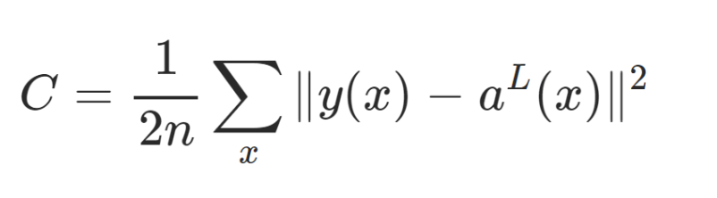
Cost (Loss) Function
A numerical value that quantifies as error which is the difference between a model's predicted and the actual value.
Quadratic cost function:
y(x) represent original value while a(x) represents predicted value

Slide 23
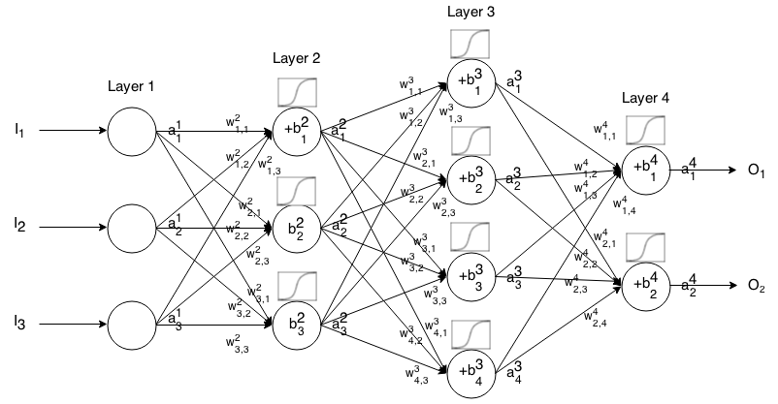
(Loss) Function
Here is a small network with all its parameters labeled:

Slide 24
(Loss) Function
How do we figure out which weights lead us to the lowest cost?
For simplicity, let’s imagine we only had one weight in our cost function w.
We want to minimize our loss/cost (overall error).
Which means we need to figure out what value of w results in the minimum of C(w)

Slide 25
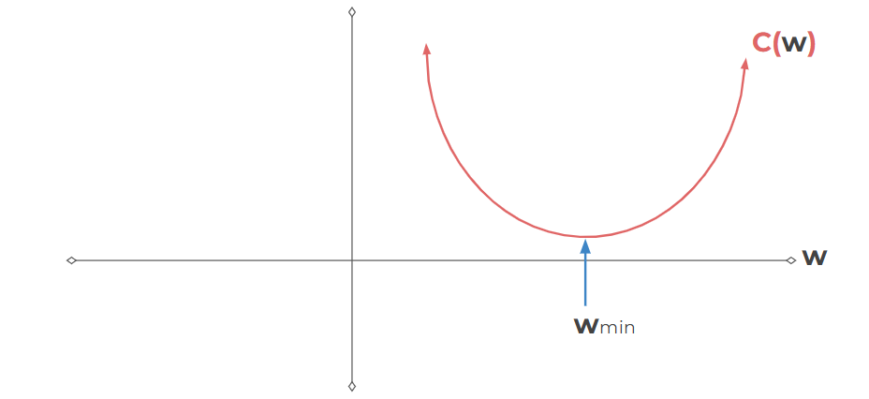
(Loss) Function
We want to minimize our loss/cost (overall error).
Which means we need to figure out what value of w results in the minimum of C(w)

Slide 26
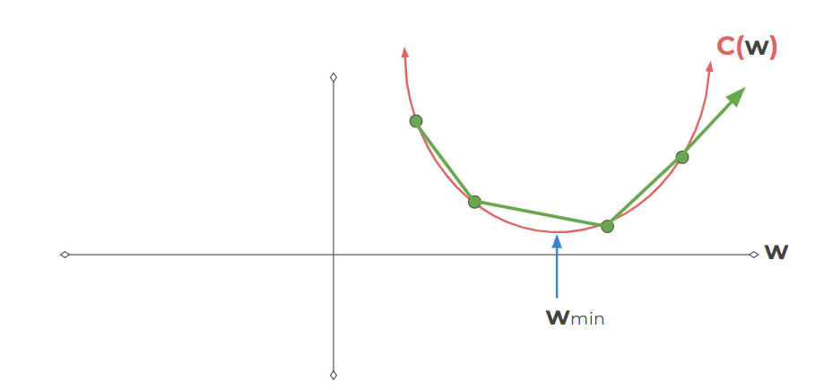
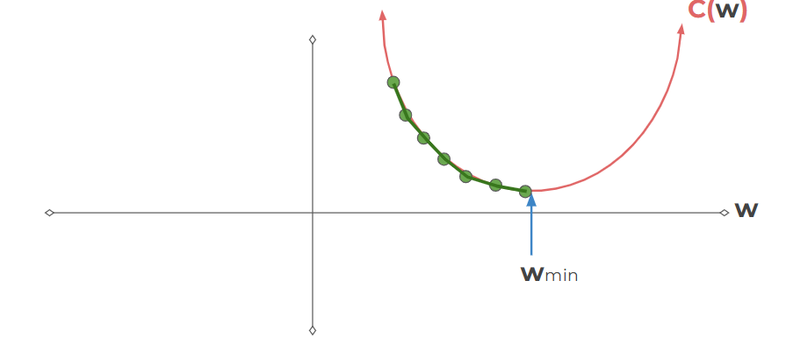
(Loss) Function
Smaller steps sizes take longer to find the minimum.
Larger steps are faster, but we risk overshooting the minimum!

Slide 27
Learning Rate
This step size is known as the learning rate.
Learning rate can be constant or varied.
Optimal approach is to start with larger steps, then go smaller as we realize the slope gets closer to zero. This is known as adaptive gradient descent.

Slide 28
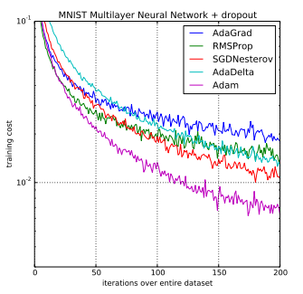
Adam
Adam is an optimizer which is used to train ANN.
Adam tends to find minimum loss by calculating updated weights(W) and bias(b) by adjusting adaptive gradient descent.
This optimizer is built-in into
Tensorflow/pytorch.

Slide 29
Convolutional Neural Networks

Slide 30
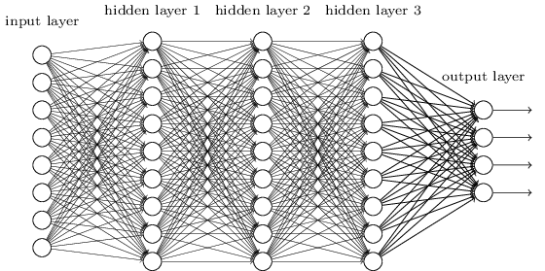
Convolutional Neural Network: CNN
We know it is good to learn a small model.
From this fully connected model, do we really need all the edges?
Can some of these be shared?

Slide 31
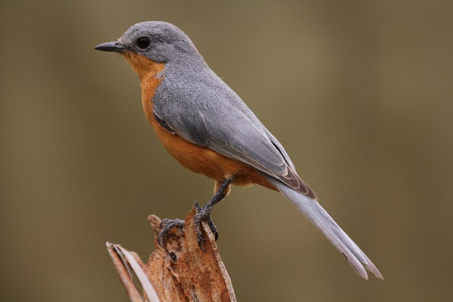
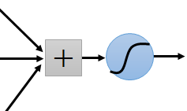
Consider learning an image:
Some patterns are much smaller than the whole image
Can represent a small region with fewer parameters
“beak” detector

Slide 32
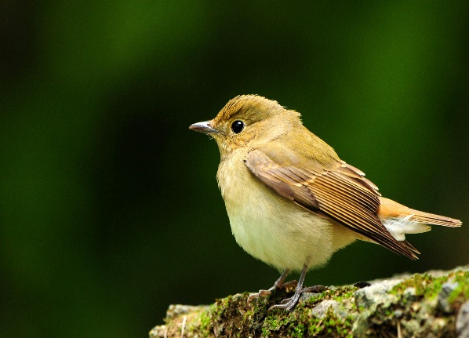
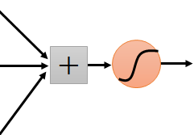
Same pattern appears in different places: They can be compressed! What about training a lot of such “small” detectors and each detector must “move around”.
“upper-left beak” detector
They can be compressed
to the same parameters.
“middle beak” detector

Slide 33
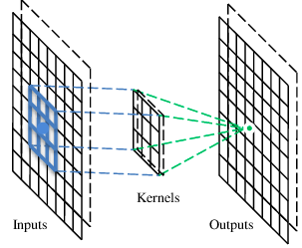
A convolutional layer
A CNN is a neural network with some convolutional layers
(and some other layers). A convolutional layer has a number
of filters that does convolutional operation.
Beak detector
A filter

Slide 34
Convolution
These are the network parameters to be learned.
1 | -1 | -1
-1 | 1 | -1
-1 | -1 | 1
1 | 0 | 0 | 0 | 0 | 1
0 | 1 | 0 | 0 | 1 | 0
0 | 0 | 1 | 1 | 0 | 0
1 | 0 | 0 | 0 | 1 | 0
0 | 1 | 0 | 0 | 1 | 0
0 | 0 | 1 | 0 | 1 | 0
Filter 1
-1 | 1 | -1
-1 | 1 | -1
-1 | 1 | -1
Filter 2
……
6 x 6 image
Each filter detects a small pattern (3 x 3).

Slide 35
Convolution
1 | -1 | -1
-1 | 1 | -1
-1 | -1 | 1
Filter 1
stride=1
1 | 0 | 0 | 0 | 0 | 1
0 | 1 | 0 | 0 | 1 | 0
0 | 0 | 1 | 1 | 0 | 0
1 | 0 | 0 | 0 | 1 | 0
0 | 1 | 0 | 0 | 1 | 0
0 | 0 | 1 | 0 | 1 | 0
Dot
product
3
-1
6 x 6 image

Slide 36
Convolution
1 | -1 | -1
-1 | 1 | -1
-1 | -1 | 1
Filter 1
If stride=2
1 | 0 | 0 | 0 | 0 | 1
0 | 1 | 0 | 0 | 1 | 0
0 | 0 | 1 | 1 | 0 | 0
1 | 0 | 0 | 0 | 1 | 0
0 | 1 | 0 | 0 | 1 | 0
0 | 0 | 1 | 0 | 1 | 0
3
-3
6 x 6 image

Slide 37
Convolution
1 | -1 | -1
-1 | 1 | -1
-1 | -1 | 1
Filter 1
stride=1
1 | 0 | 0 | 0 | 0 | 1
0 | 1 | 0 | 0 | 1 | 0
0 | 0 | 1 | 1 | 0 | 0
1 | 0 | 0 | 0 | 1 | 0
0 | 1 | 0 | 0 | 1 | 0
0 | 0 | 1 | 0 | 1 | 0
3
-1
-3
-1
-3
1
0
-3
-3
-3
0
1
3
-2
-2
-1
6 x 6 image

Slide 38
Convolution
-1 | 1 | -1
-1 | 1 | -1
-1 | 1 | -1
Filter 2
stride=1
Repeat this for each filter
1 | 0 | 0 | 0 | 0 | 1
0 | 1 | 0 | 0 | 1 | 0
0 | 0 | 1 | 1 | 0 | 0
1 | 0 | 0 | 0 | 1 | 0
0 | 1 | 0 | 0 | 1 | 0
0 | 0 | 1 | 0 | 1 | 0
3
-1
-3
-1
-1
-1
-1
-1
-3
1
0
-3
-1
-1
-2
1
Feature
Map
-3
-3
0
1
-1
-1
-2
1
3
-2
-2
-1
6 x 6 image
-1
0
-4
3
Two 4 x 4 images
Forming 2 x 4 x 4 matrix

Slide 39
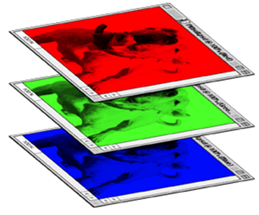
Color image: RGB 3 channels
1 | -1 | -1
-1 | 1 | -1
-1 | -1 | 1
-1 | 1 | -1
-1 | 1 | -1
-1 | 1 | -1
1 | -1 | -1
-1 | 1 | -1
-1 | -1 | 1
-1 | 1 | -1
-1 | 1 | -1
-1 | 1 | -1
1 | -1 | -1
-1 | 1 | -1
-1 | -1 | 1
-1 | 1 | -1
-1 | 1 | -1
-1 | 1 | -1
Filter 1
Filter 2
Color image
1 | 0 | 0 | 0 | 0 | 1
0 | 1 | 0 | 0 | 1 | 0
0 | 0 | 1 | 1 | 0 | 0
1 | 0 | 0 | 0 | 1 | 0
0 | 1 | 0 | 0 | 1 | 0
0 | 0 | 1 | 0 | 1 | 0
1 | 0 | 0 | 0 | 0 | 1
0 | 1 | 0 | 0 | 1 | 0
0 | 0 | 1 | 1 | 0 | 0
1 | 0 | 0 | 0 | 1 | 0
0 | 1 | 0 | 0 | 1 | 0
0 | 0 | 1 | 0 | 1 | 0
1 | 0 | 0 | 0 | 0 | 1
0 | 1 | 0 | 0 | 1 | 0
0 | 0 | 1 | 1 | 0 | 0
1 | 0 | 0 | 0 | 1 | 0
0 | 1 | 0 | 0 | 1 | 0
0 | 0 | 1 | 0 | 1 | 0

Slide 40
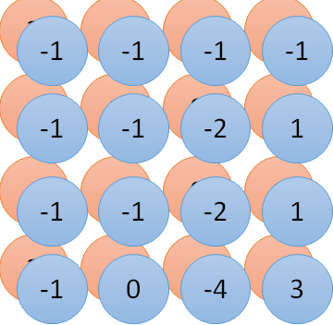
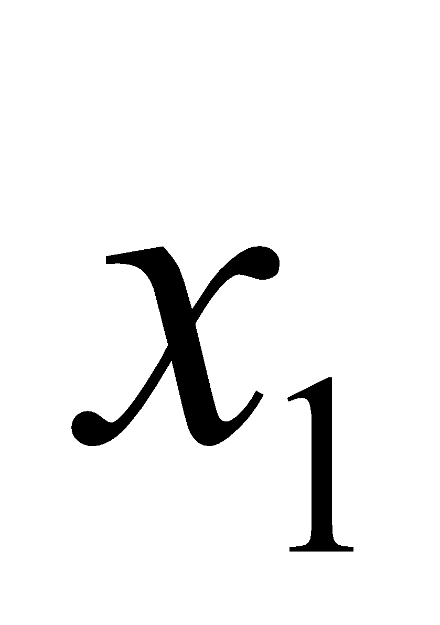
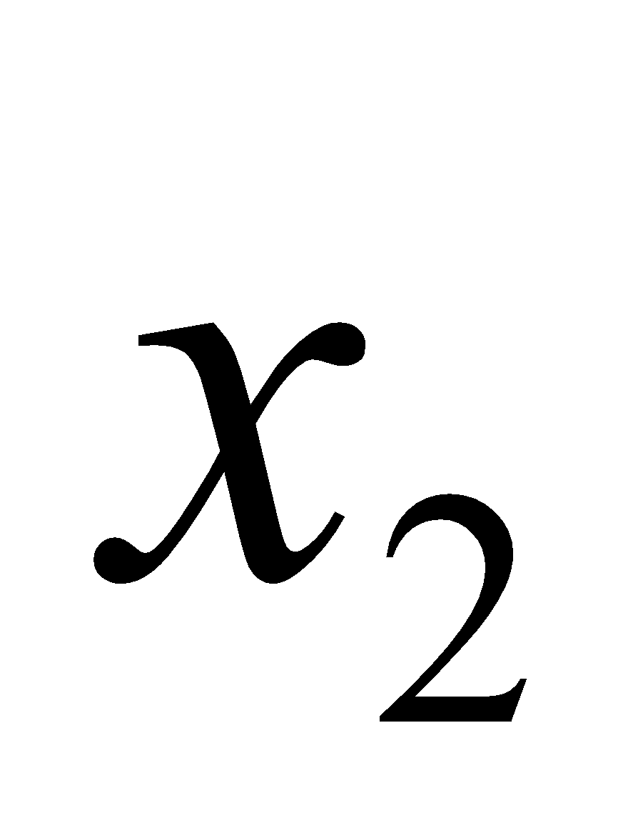
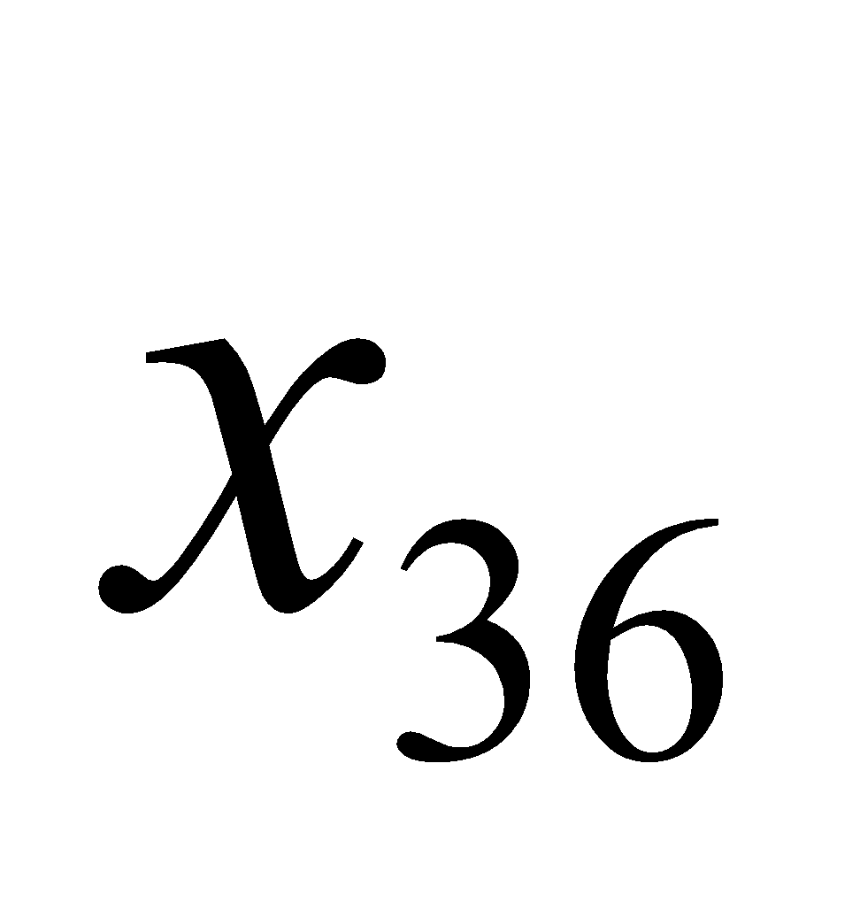
Convolution v.s. Fully Connected
1 | 0 | 0 | 0 | 0 | 1
0 | 1 | 0 | 0 | 1 | 0
0 | 0 | 1 | 1 | 0 | 0
1 | 0 | 0 | 0 | 1 | 0
0 | 1 | 0 | 0 | 1 | 0
0 | 0 | 1 | 0 | 1 | 0
1 | -1 | -1
-1 | 1 | -1
-1 | -1 | 1
-1 | 1 | -1
-1 | 1 | -1
-1 | 1 | -1
convolution
image
1 | 0 | 0 | 0 | 0 | 1
0 | 1 | 0 | 0 | 1 | 0
0 | 0 | 1 | 1 | 0 | 0
1 | 0 | 0 | 0 | 1 | 0
0 | 1 | 0 | 0 | 1 | 0
0 | 0 | 1 | 0 | 1 | 0
Fully-connected
……
……

Slide 41
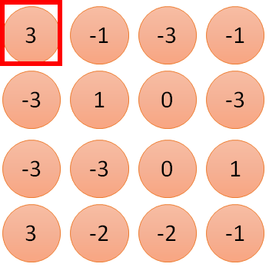
1 | -1 | -1
-1 | 1 | -1
-1 | -1 | 1
1
1
Filter 1
2
0
3
0
3
4:
0
1 | 0 | 0 | 0 | 0 | 1
0 | 1 | 0 | 0 | 1 | 0
0 | 0 | 1 | 1 | 0 | 0
1 | 0 | 0 | 0 | 1 | 0
0 | 1 | 0 | 0 | 1 | 0
0 | 0 | 1 | 0 | 1 | 0
…
0
8
1
9
0
10:
0
…
13
0
6 x 6 image
14
0
fewer parameters!
15
Only connect to 9 inputs, not fully connected
1
16
1
…

Slide 42
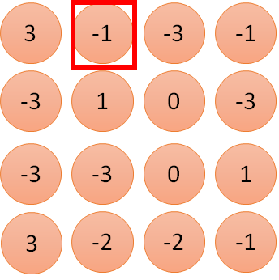
1 | -1 | -1
-1 | 1 | -1
-1 | -1 | 1
1:
1
Filter 1
2:
0
3:
0
3
4:
0
1 | 0 | 0 | 0 | 0 | 1
0 | 1 | 0 | 0 | 1 | 0
0 | 0 | 1 | 1 | 0 | 0
1 | 0 | 0 | 0 | 1 | 0
0 | 1 | 0 | 0 | 1 | 0
0 | 0 | 1 | 0 | 1 | 0
…
7:
0
8:
1
-1
9:
0
10:
0
…
13:
0
6 x 6 image
14:
0
Fewer parameters
15:
1
16:
1
Shared weights
Even fewer parameters
…

Slide 43
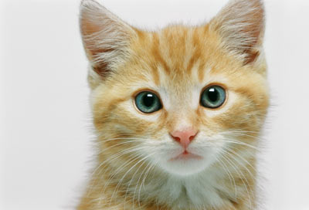
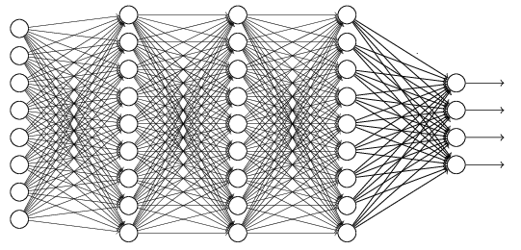
The whole CNN
cat dog ……
Convolution
Max Pooling
Can repeat many times
Fully Connected Feedforward network
Convolution
Max Pooling
Flattened

Slide 44
Max Pooling
1 | -1 | -1
-1 | 1 | -1
-1 | -1 | 1
-1 | 1 | -1
-1 | 1 | -1
-1 | 1 | -1
Filter 1
Filter 2
3
-1
-3
-1
-1
-1
-1
-1
-3
1
0
-3
-1
-1
-2
1
-3
-3
0
1
-1
-1
-2
1
3
-2
-2
-1
-1
0
-4
3

Slide 45
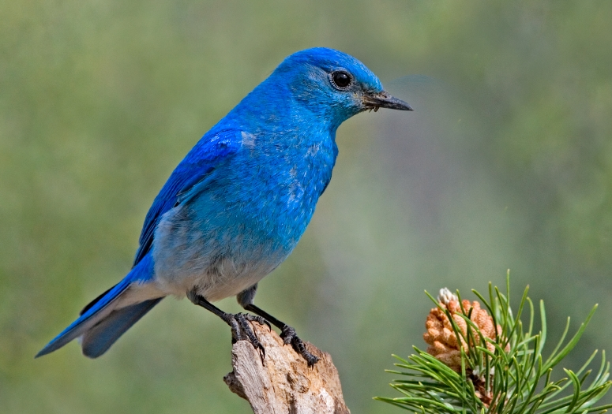

Why Pooling
Subsampling pixels will not change the object
bird
bird
Subsampling
We can subsample the pixels to make image smaller
fewer parameters to characterize the image

Slide 46
A CNN compresses a fully connected network in two ways:
Reducing number of connections
Shared weights on the edges
Max pooling further reduces the complexity

Slide 47
Max Pooling
New image
but smaller
1 | 0 | 0 | 0 | 0 | 1
0 | 1 | 0 | 0 | 1 | 0
0 | 0 | 1 | 1 | 0 | 0
1 | 0 | 0 | 0 | 1 | 0
0 | 1 | 0 | 0 | 1 | 0
0 | 0 | 1 | 0 | 1 | 0
Conv
3
0
-1
1
Max
Pooling
3
1
0
3
2 x 2 image
6 x 6 image
Each filter
is a channel

Slide 48
The whole CNN
3
0
-1
1
Convolution
3
1
0
3
Max Pooling
Can repeat many times
A new image
Convolution
Smaller than the original image
The number of channels is the number of filters
Max Pooling

Slide 49
The whole CNN
cat dog ……
Convolution
Max Pooling
Fully Connected Feedforward network
A new image
Convolution
Max Pooling
Flattened
A new image

Slide 50
Flattening
3
0
1
3
0
-1
1
3
3
1
-1
0
3
Flattened
1
Fully Connected Feedforward network
0
3

Slide 51


CNN in Keras
Only modified the network structure and input format (vector -> 3-D tensor)
input
Convolution
1 | -1 | -1
-1 | 1 | -1
-1 | -1 | 1
-1 | 1 | -1
-1 | 1 | -1
-1 | 1 | -1
There are 25 3x3 filters.
……
Max Pooling
Input_shape = ( 28 , 28 , 1)
28 x 28 pixels
1: black/white, 3: RGB
Convolution
3
-1
3
Max Pooling
-3
1

Slide 52
CNN
In a CNN:
Early layers → detect very generic features like edges, corners, textures, and colors. These are useful for almost all images (cats, dogs, lungs, X-rays, etc.).
Middle layers → detect patterns like shapes, motifs, parts of objects.
Deeper layers (last few blocks) → detect task-specific features (dog faces, wheels, medical tissue patterns, etc.).

Slide 53
Pretrained Models
Introduction to Transfer Learning

Slide 54
Pretrained Models
Deep learning on smaller datasets.
Pretrained: A pretrained network is a saved network that was previously trained on a large dataset, typically on a large-scale image classification task.
Generic Model: If trained on large and diverse dataset, then this model will become generic for related smaller datasets.
Learned Features: For instance, a model originally trained over imagenet (a larger dataset containing animals and every day objects) than this model can help in furniture identification tasks. (because furniture images also contain animals and every day objects)

Slide 55
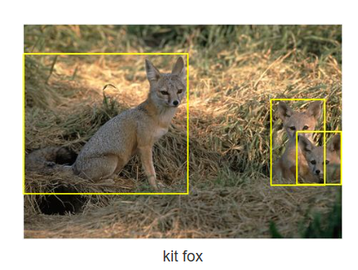
IMAGE-NET
It contains over 14 million images across 21,000+ categories.
There is no fixed size of each image. Sizes varies from images to images.
These images are collected from internet.
Images are also annotated with bounding boxes.
For training deep learning models (e.g., AlexNet, ResNet), images are typically resized to 224×224 pixels.

Slide 56
Pre-trained Models
Pretrained models can be used in two ways
Feature Extraction
Fine Tunning

Slide 57
Features Extraction
Feature (edges, textures, patterns, shapes) extraction consists of using the representations learned by a previous network to extract interesting features from new samples to train a from-scratch classifier.
Feature extraction consists of taking the convolutional base of a previously trained model and running the data through it and training a new classifier.

Slide 58
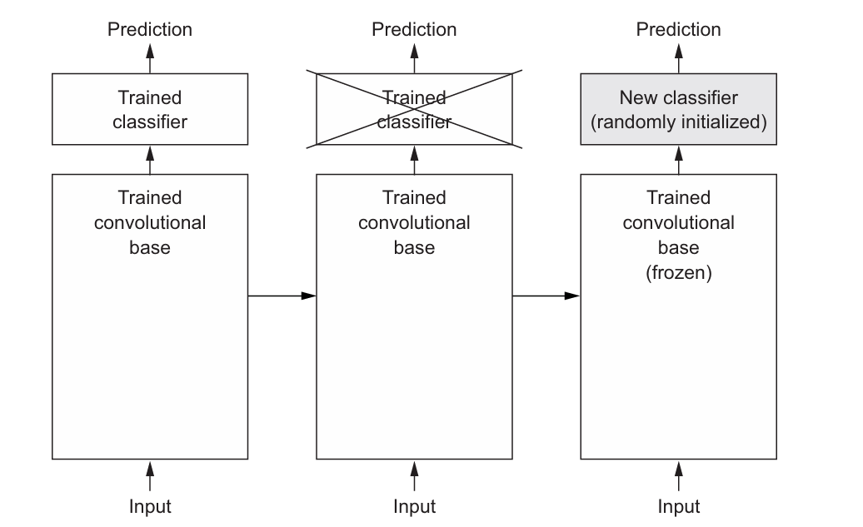
Features Extraction

Slide 59
Features Extraction
How this is different from Scratch CNN?

Slide 60
List of Pretrained Models
Xception
Inception V3
ResNet50
VGG16
VGG19
MobileNet

Slide 61
VGG-16
It was proposed by the Visual Geometry Group (VGG) at the University of Oxford.
It is characterized by its depth, consisting of 16 layers, including 13 convolutional layers and 3 fully connected layers.
Input: 224×224 RGB image (3 channels)
Layers: 13 convolutional layers + 3 fully connected layers = 16 weight layers
Kernel size: All convolution layers use 3×3 filters, stride 1, padding SAME
Final classifier: Fully connected layers + softmax (for 1000 classes)

Slide 62
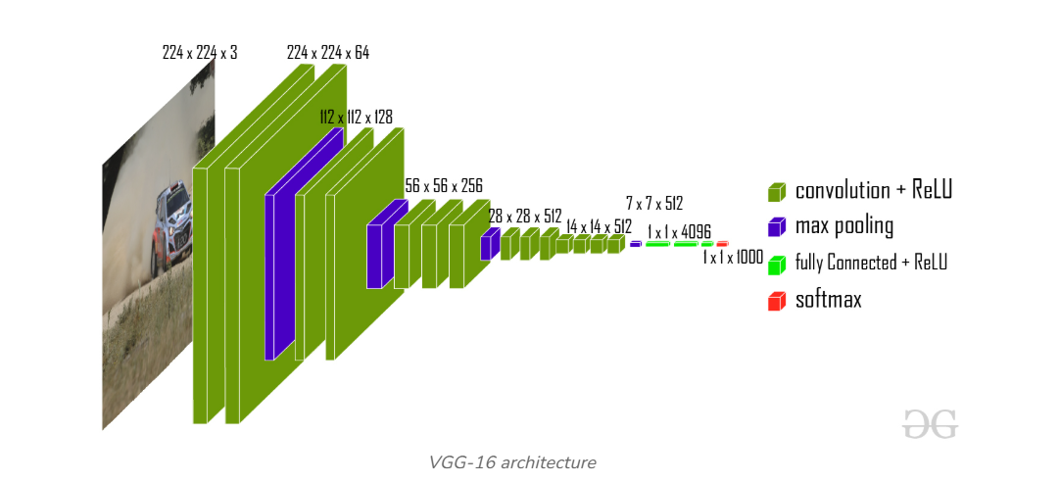
VGG-16

Slide 63
VGG-16
from keras.applications import VGG16
conv_base = VGG16(weights='imagenet’,
include_top=False,
input_shape=(150, 150, 3))
include_top refers to including (or not) the densely connected classifier on top of the network. We are not including them as we intends to use only non-classifier layers.

Slide 64
Fine Tunning
Fine-tuning consists of unfreezing a few of the top layers of a frozen model base used for feature extraction, and jointly training both the newly added part of the model.

Slide 65
Fine Tunning
conv_base.trainable = True
set_trainable = False
for layer in conv_base.layers:
if layer.name == 'block5_conv1’:
set_trainable = True
if set_trainable:
layer.trainable = True
else:
layer.trainable = False

